Slide 1
Intervention models and standardized residuals for perturbation analysis
Eli Holmes
FISH 507 – Applied Time Series Analysis
12 March 2019

Slide 2


Big question in the finance world
What is the effect of advertising on sales?
Anheuser-Busch
spends $35 million/yr
on Super Bowl ads
$95 million/yr in revenue
(170% return!)
©Budweiser
How do they know this?
Hartman et al (2015)

Slide 3
How much did sales change?

Slide 4
Model from finance world
Sales
State equation
Advertising effect
Indicator function
Hamilton (1989), West & Harrison (1997)

Slide 5
Model from finance world
State equation
Step change

Slide 6
Model from finance world
State equation
Continual change

Slide 7
Model from finance world
Sales
State equation
Advertising effect
Advertising expense
Hamilton (1989), West & Harrison (1997)

Slide 8
Model from finance world
State equation

Slide 9
Model from finance world
State equation

Slide 10
What about interventions in obs?
It is entirely possible for their to be a change (intervention) in the observations
Field ecology (fisheries, ornithology)
Laboratory (microscopy, genetics, chemistry)

Slide 11
Model for change in observation
State equation
Observation equation
Intervention
effect
Indicator function

Slide 12

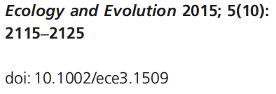

Slide 13
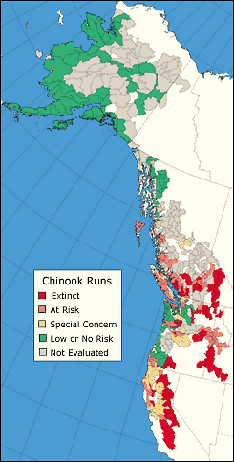
The salmon story
Major declines in populations across the continental U.S. & southern Canada
Evolutionary Significant Units (ESUs) form basis for conservation & management
28/52 ESUs listed as threatened or endangered under U.S. Endangered Species Act
Human (eg, dams, harvest) & natural (climate) causes have contributed to declines
Big money business ($4 billion per decade)
Source: State of the Salmon

Slide 14
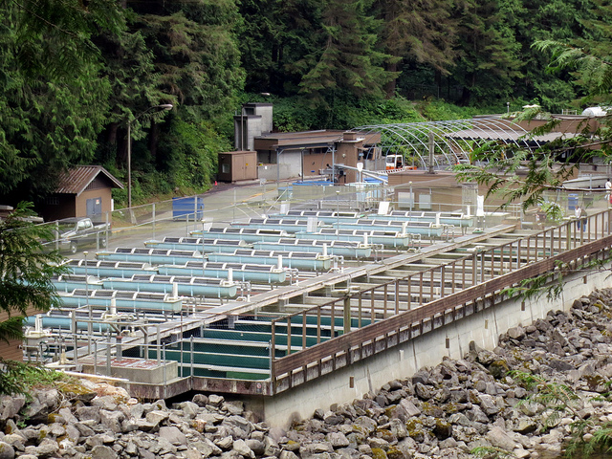
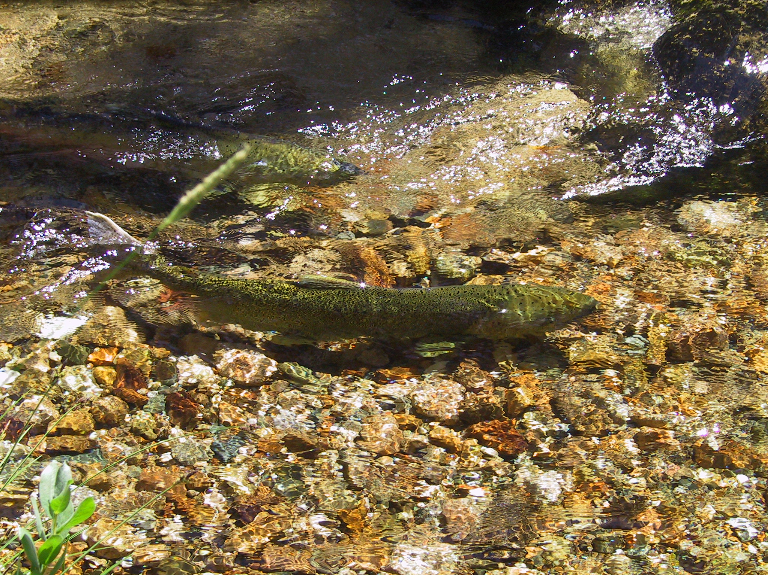
Adverse effects of hatcheries
Growing evidence that hatchery fish have reduced fitness & adverse demographic effects
(eg, Araki et al. 2007, Buhle et al. 2009, Christie et al. 2014)
©Ruth Hartnup

Slide 15
The big picture
Question
What is the effect of hatchery supplementation on Snake River spring/summer Chinook salmon at
population level, and
broader ESU scale?

Slide 16
Time series of spawner density

Slide 17
Time series of supplementation

Slide 18
Model for supplementation
True density
State equation
Common year effect

Slide 19
Model for supplementation
True density
State equation
Supplementation effect
Indicator function

Slide 20
Model for supplementation
State equation

Slide 21
Model for supplementation
True density
State equation
Supplementation effect
Indicator function
Observation equation
Observed density

Slide 22
Distribution of intervention sizes
Mean 95% CI Pr(+)
0.033 (-0.077, 0.15) 0.73
ESU-level:
Notes:
MAR(1) Workshop - ESA 2007, San Jose, CA
5 Aug 2007

Slide 23
Summary
Intervention models are used in many fields
Intervention models can take many forms

Slide 24
standardized residuals

Slide 25
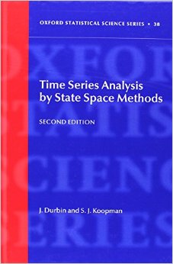
Detection of outliers and structural breaks using standardized residuals
See the chapter on outlier and structural break detection in the HWS (MARSS User Guide)
de Jong, P. and Penzer, J. 1998. Diagnosing shocks in time series. Journal of the American Statistical Association 93:796-806.
Durbin and Koopman. 2012. Time series analysis by state-space methods. Chapter 2, Section 12

Slide 26
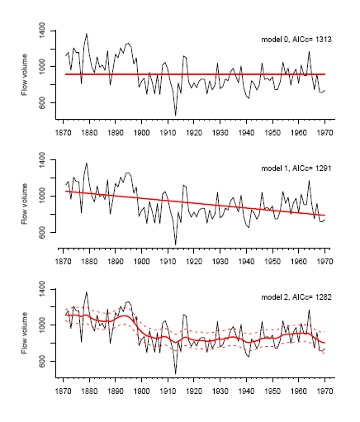
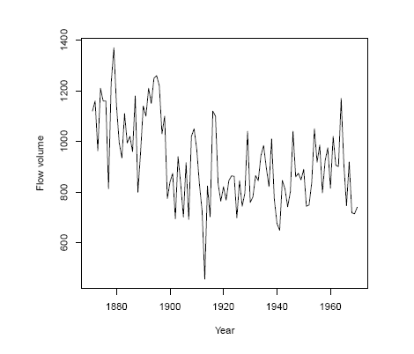
Back to the Nile River data
Three different models
River flow by year

Slide 27
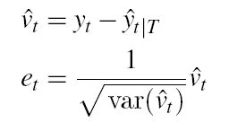
Observation outlier detection
Three different models
Observation outlier: observation (data) at time t is different than what you would expect given the model.
obs. residual = data – fitted value
we standardize by the estimated variance and get a t-distributed standardized residual
This idea hinges on v(t) being normal so that means it hinges on the model being able to fit the data (= put a line through the data)

Slide 28
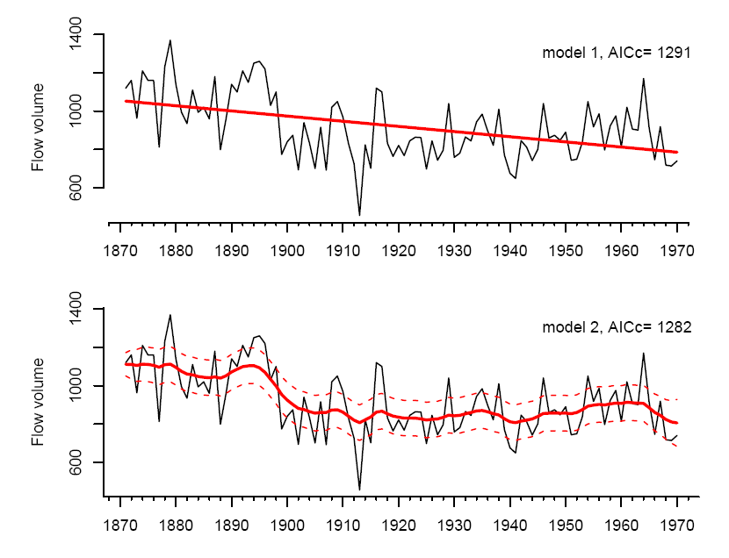
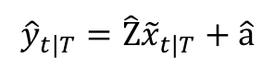
Observation residual in the context of state-space models
for a linear regression, ‘fitted y’ is easy.
obs. residual = data – fitted value
$${\hat{y}}_{t|T}=\hat{\text{Z}}{\tilde{x}}_{t|T}+\hat{\text{a}}$$
you need to standardize by the variance of that, which is a bit hairy but algorithms for computing it are worked out.
for a state-space model, there isn’t one ‘fitted y’. ‘fitted y’ has a distribution.

Slide 29
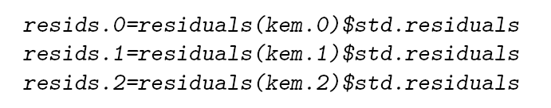
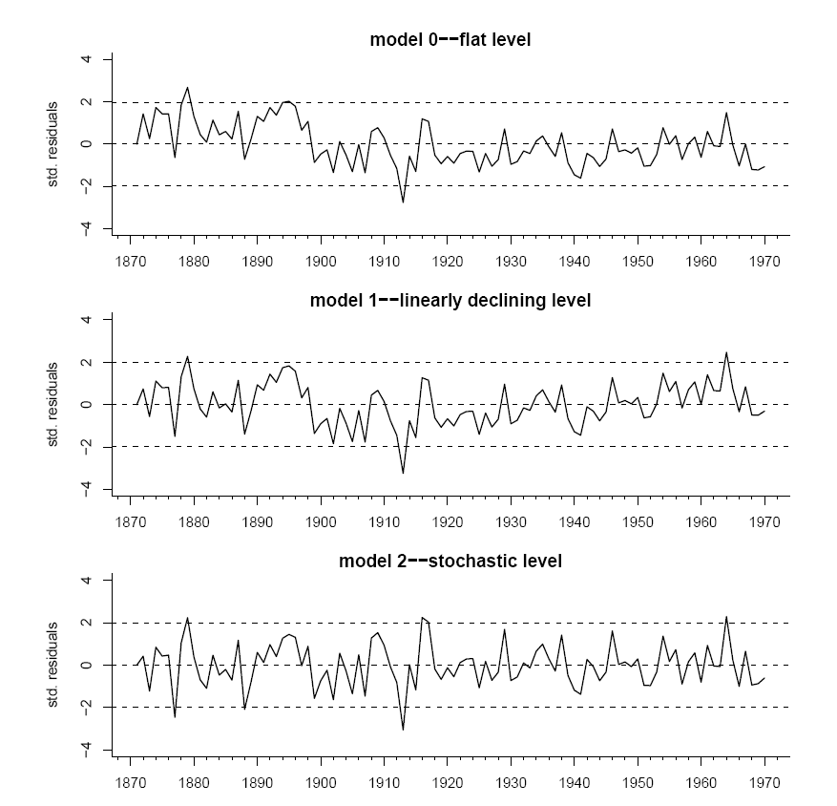
Note, the standard concerns regarding setting test levels for multiple tests exist

Slide 30
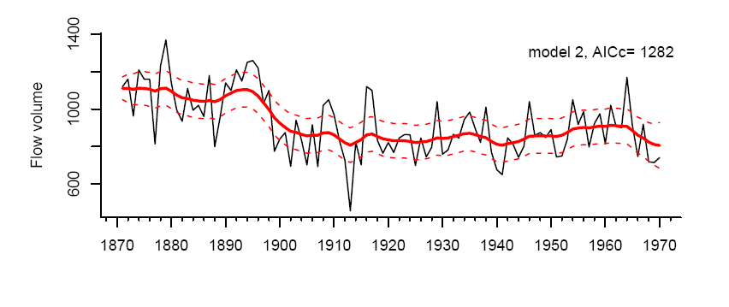
“Structural break detection” aka testing state outliers
Idea is to test whether observed changes in the stochastic state (in this example level) were more unusual than you would expect given the estimated MAR model for the state.

Slide 31
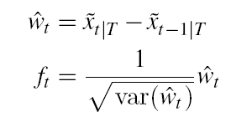
“Structural break detection” aka testing state outliers
Three different models
State outlier: estimated state at time t+1 is different than what you would expect given the model.
state. residual =
we standardize by the estimated variance and get a t-distributed standardized residual
Again this idea hinges on w(t) being normal so that means it hinges on the model being able to fit the data (= put a line through the data)

Slide 32
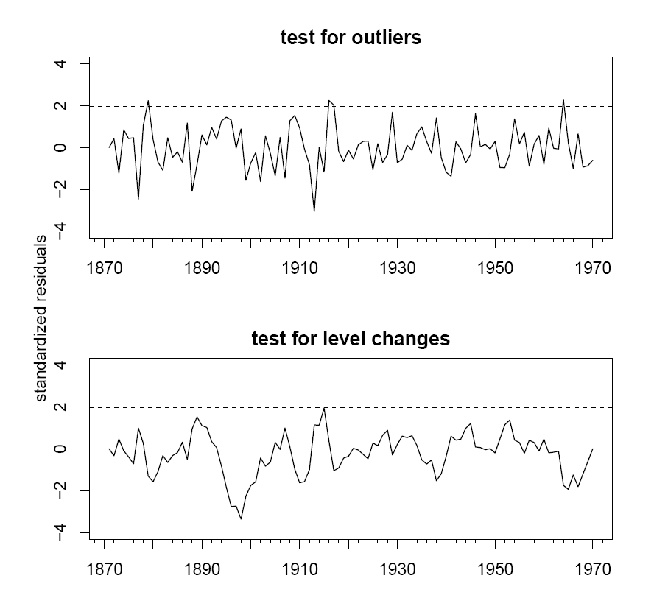
Note, the standard concerns regarding setting test levels for multiple tests exist

Slide 33
Summary
Residual analysis is a diagnostic tool to look for observation or state outliers and evidence of times when the underlying model is violated, but there is no cause involved.
Intervention analysis is more suited to a mechanistic analysis of changes/breaks that may or may not have occurred.

